Slide 1

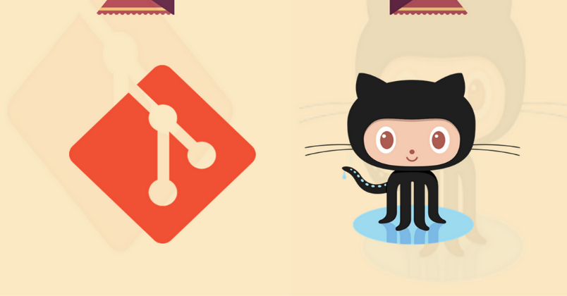
Git and GitHub
Qasir Hassan
MCA 2nd Sem
Roll No: 040
Github.com/sahilqaiser
http://bit.ly/Git_ppt

Slide 2
What is GIT?
GIT is a Version Control System for tracking changes in computer files and coordinating work on those files among multiple people.
~ Wikipedia

Slide 3
Special Features of GIT :
Git is a Distributed VCS.
Git Coordinates work between multiple Authors.
Git keeps track of changes with extra details like Author, Timestamp, change Type etc.
Git can help you revert back any change.
Git can work Offline too.

Slide 4
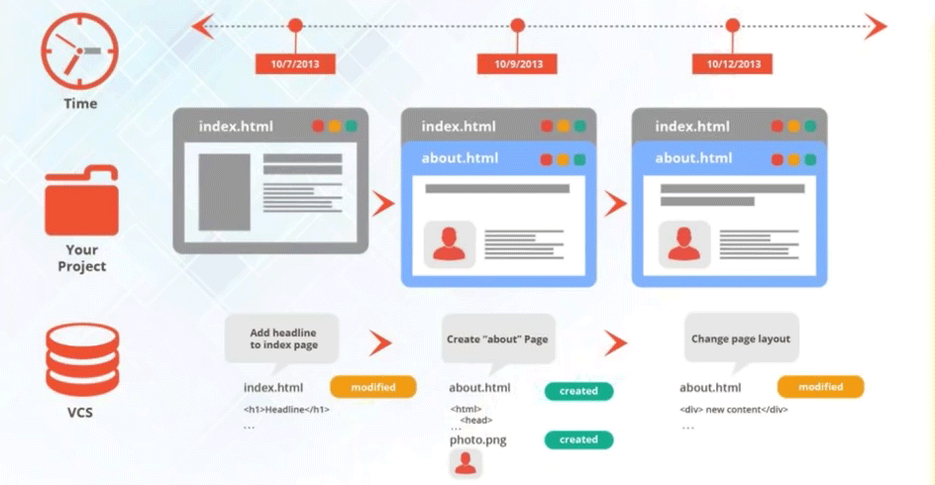
GIT

Slide 5
GIT HOW?
How GIT Keeps Track of Change History :
Git Takes SNAPSHOTS of the Files and Folders (i.e. Project).
We Can visit any of these SNAPSHOTS anytime.
We can Stage File Before SNAPSHOTING them.
SO WHAT ARE SNAPSHOTS???

Slide 7
GIT HOW?
How GIT Keeps Track of Change History :
Git Takes SNAPSHOTS of the Files and Folders (i.e. Project).
We Can visit any of these SNAPSHOTS anytime.
We can Stage File Before SNAPSHOTING them.
SO WHAT ARE SNAPSHOTS???

